Slide 1
Module 5: Describing changes in spatial patterns over time
Michael Otterstatter, PhD
Analytic Capacity Building Initiative: Workshop in Geospatial Methods
September 17-18, 2019, Calgary, Alberta

Slide 2
Outline
Background and concepts
including time in a spatial analysis
maps with a time component
Analysis of space-time data
Cluster detection with a time component
Illustrative example
R script: Adding to time to spatial analysis and visualization
R script: Adding time to cluster detection
References and other resources

Slide 3
Background and concepts

Slide 4
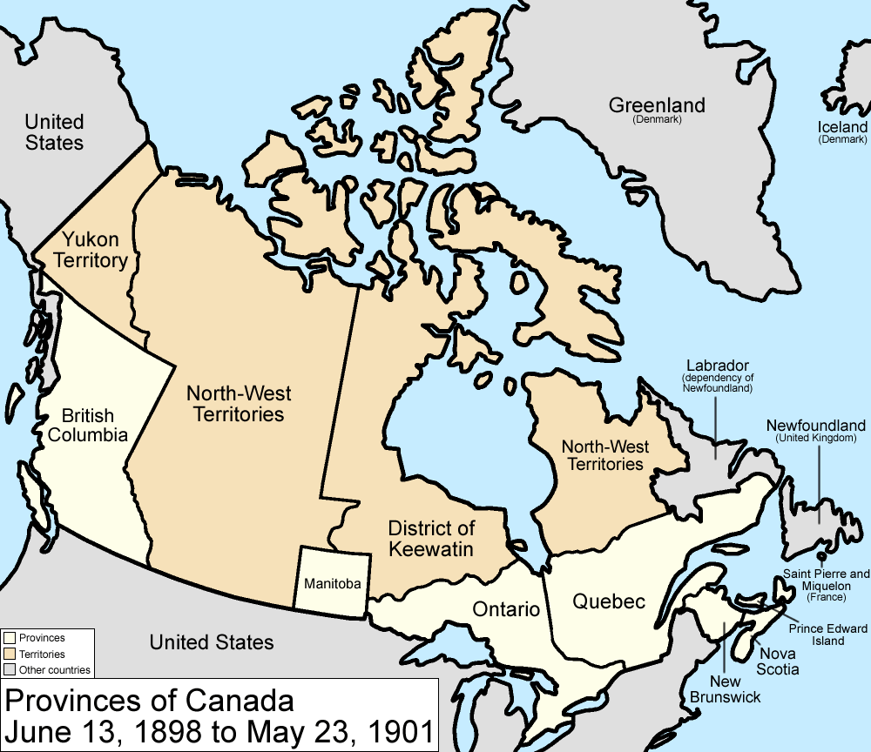
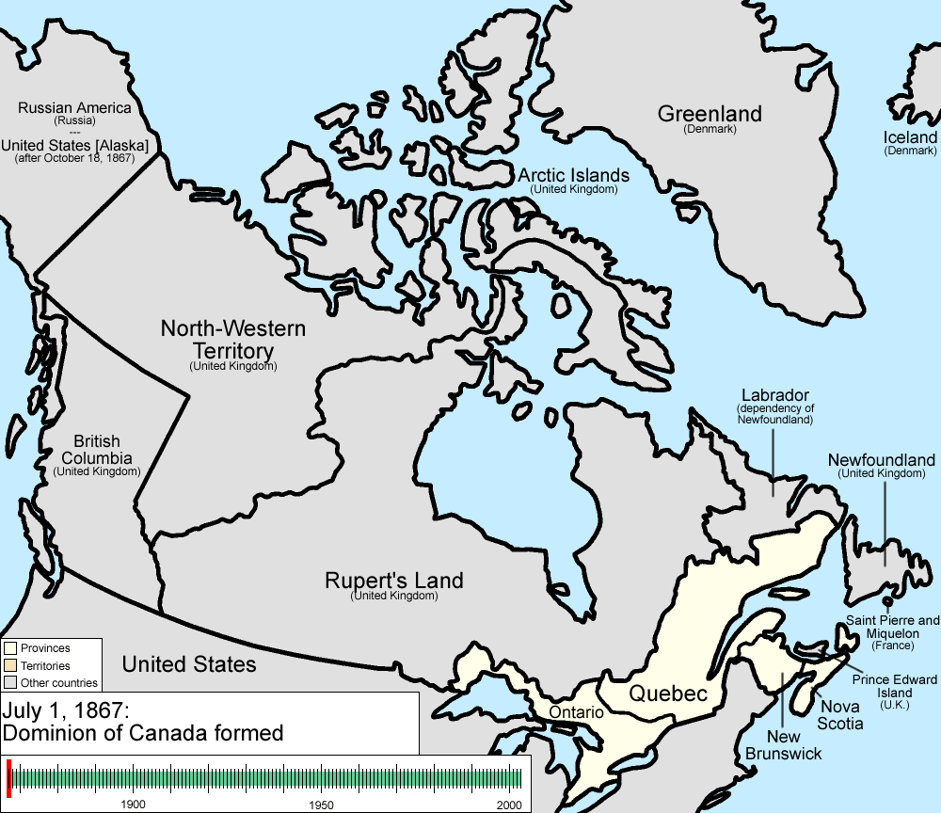
Including time in a spatial analysis
Background and concepts
Often, time is ignored in a spatial analysis -- we examine patterns in observations across locations but typically do not distinguish when these observations occurred
This is appropriate in many cases, but does not allow us to understand changes in spatial pattern over time
https://en.wikipedia.org/wiki/File:Canada_provinces_evolution_2.gif

Slide 5
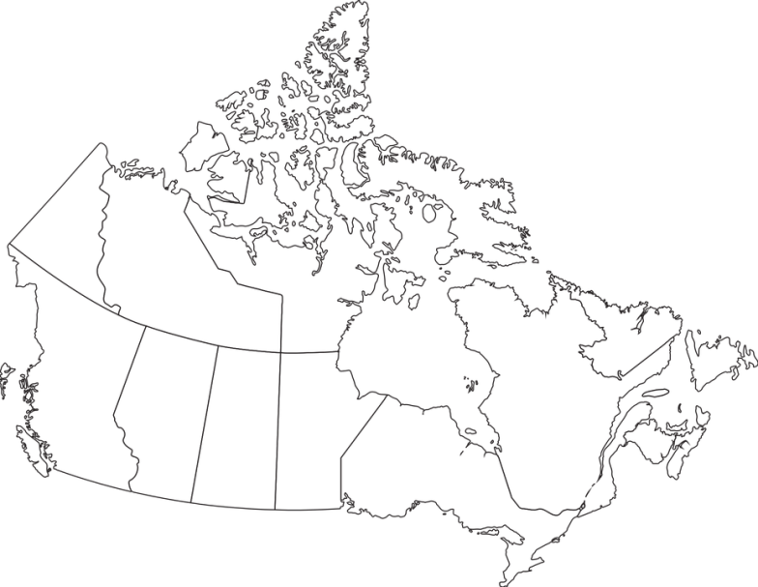


Including time in a spatial analysis
Background and concepts
Note that with the addition of time to spatial data, several data types become possible, including observations with:
location but no duration (e.g., birth or death)
both location and duration, but no movement (e.g. address of a hospital)
duration and movement (e.g., a person’s location/residence over time)
Appropriate analysis and visualization will depend on which type(s) of data we have

Slide 6
Including time in a spatial analysis
Background and concepts
A simple way to include time in our analysis is to imagine a data set of observations at n fixed locations, each of which has values for t time points
note, the locations and time points need not be regularly spaced units
Location | Time 1 | Time 2 | Time 3 | . | . | . | t
1
2
3
4
.
.
.
n

Slide 7
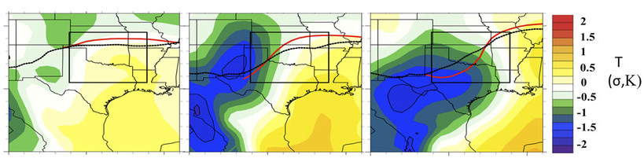
Maps with a time component
Background and concepts
One visualisation of these data is the multi-panel plot (also call facetted, or lattice, plot)
each panel represents a time point (snapshot) at a particular location (defined by spatial x and y axes)
all panels use a common x axis, y axis and legend
or, the x and y axes could represent time and value, respectively, and the panels represent spatial locations
Time 1 Time 2 Time 3

Slide 8
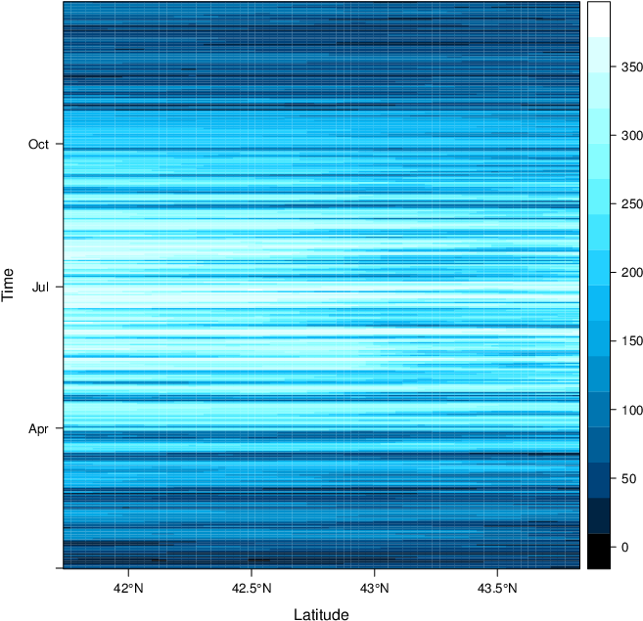
Maps with a time component
Background and concepts
Another visualisation is the pure space-time plot
spatial location is shown on the x axis, time on the y axis
value at a particular location and time is represented by an aesthetic property such as colour (e.g., darker shades represent larger values)
https://oscarperpinan.github.io/spacetime-vis/spacetime.html

Slide 9
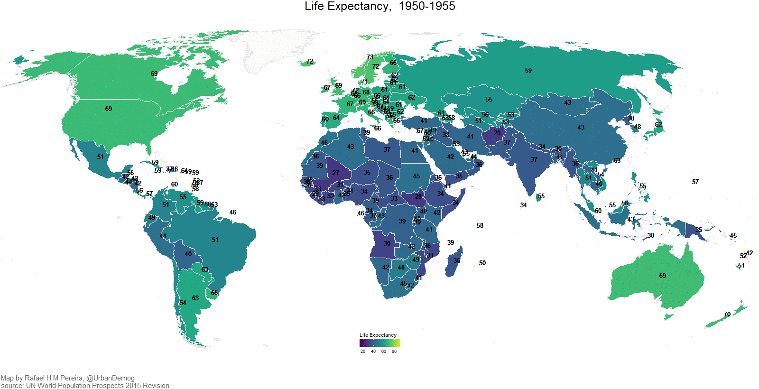
Maps with a time component
Background and concepts
Finally, an animated map can be used to effectively communicate both spatial and temporal information
can be static or interactive (similar to non-animated maps)

Slide 10

Considerations and cautions
Background and concepts
Standardization of axes and legends is essential for comparability in multi-panel plots
More generally, certain aesthetics become important when showing changes over time (e.g., appropriate and consistent scale, symbology and colouring), but are not be reviewed in detail here

Slide 11
Space-time cluster detection

Slide 12
Background
Space-time clusters
Literature on analysis of space time data often concerns the building and evaluation of statistical models (e.g., complex regressions)
Here, we consider only one particular application: detecting clusters in space and time
A more comprehensive treatment of space-time modeling is given by Wikle et al., 2019

Slide 13
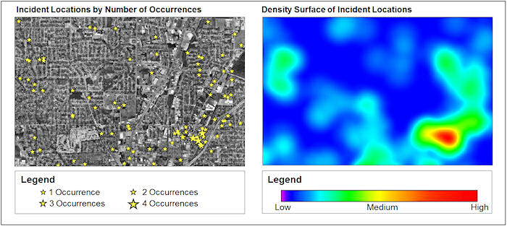
Cluster detection with a time component
Space-time clusters
Detecting spatial clusters over time is a common motivation to include time in a spatial analysis
We may be interested in
finding clusters that are localized not just in space, but also in time (e.g., elevated event counts in a certain neighbourhood but only for a certain period)
monitoring an area for changes in patterns of spatial autocorrelation, perhaps suggesting newly emerging hotspots or coldspots
https://blog.hexagongeospatial.com/wp-content/uploads/hotspot-density-surface.jpg

Slide 14
Illustrative example

Slide 15
Adding time to spatial analysis
Illustrative example
R script: Adding to time to spatial analysis and visualization

Slide 16
Detecting space-time clusters
Illustrative example
R script: Adding time to cluster detection

Slide 17
References and resources
Fotheringham, A.S. and Rogerson, P.A., eds. 2008. The SAGE handbook of spatial analysis. Sage.
Lamigueiro, Ó.P., 2014. Displaying time series, spatial, and space-time data with R. Chapman and Hall/CRC.
Wikle, C.K., Zammit-Mangion, A., and Cressie, N. (2019). Spatio-Temporal Statistics with R. Chapman & Hall/CRC, Boca Raton, FL.

